Slide 1
Spell corrections – N gram model and Minimum Edit distance

Slide 2
Spell Correction
Frequency of spelling errors in human typed text varies
– 0.05% of the words in carefully edited journals
– 38% in difficult applications like telephone directory lookup
• Word-based spell correction checks each word in a dictionary/lexicon
– Detecting spelling errors that result in non-words
– mesage -> message by looking only at the word in isolation
– May fail to recognize an error (real-word errors)
• Typographical errors e.g. there for three
• Homonym or near-homonym e.g. dessert for desert, or piece for peace
• Use context of preceding word and language model to choose correct word
– Japanese Empirical Navy -> Japanese Imperial Navy

Slide 3
Different types of spelling errors
Non-word Errors: miss a few keystrokes or let your fingers hurtle a bit longer.
e.g., typing langage when you meant language; or hurryu when you meant hurry
Real Word Errors: end up creating a real word, but not intending for that word.
e.g. typing buckled when you meant bucked. Or your fingers are a tad wonky, and you type in three when you meant there.
Cognitive Errors: from ignorance of a word or its correct spelling.
e.g. The words piece and peace are homophones (sound the same).
Short forms/Slang/Lingo: These are possibly not even spelling errors. May be u r just being kewl or wants to write everything within a text message or a tweet.
Intentional Typos: type in teh carefully and frown if it gets autocorrected.

Slide 4
Spelling Tasks
Spelling Error Correction:
Autocorrect
hte→ the
Suggest a correction
Suggestion lists

Slide 5
Non-word spelling errors
Non-word spelling error detection:
Any word not in a dictionary is an error
Non-word spelling error correction:
Generate candidates: real words that are similar to the misspelled word
Choose the one which is best:
Shortest weighted edit distance
Highest noisy channel probability

Slide 6
Real word spelling errors
For each word w, generate candidate set:
Find candidate words with similar pronunciations
Find candidate words with similar spelling
Include w in candidate set

Slide 7
Non-word spelling error example
acress

Slide 8
Unigram Prior probability
Counts from 404,253,213 words in Corpus of Contemporary English (COCA)
word | Frequency of word | P(word)
actress | 9,321
cress | 220
caress | 686
access | 37,038
across | 120,844
acres | 12,874

Slide 9
Unigram Prior probability
Counts from 404,253,213 words in Corpus of Contemporary English (COCA)
word | Frequency of word | P(word)
actress | 9,321 | .0000230573
cress | 220 | .0000005442
caress | 686 | .0000016969
access | 37,038 | .0000916207
across | 120,844 | .0002989314
acres | 12,874 | .0000318463

Slide 10
Issue and approach
Basic issue:
- Lexicon (all wordforms including proper noun)
- Total no of entries ~ 10⁵ to 10⁶
Solution:
Filtering (fast algorithm to pick up most likely words)
Go for an algorithm for analyzing the most likely words and the output is the intended word.
Complex algorithm – Minimum Edit distance

Slide 11
Unigram Frequencies to Maximize Likelihood
Suppose, the word (typed) is “the”
Intended Word?
Suppose, the word (typed) is “thew”
Intended word ?
Anyone from this list:
If no spelling error, how do you know that typed word is the correct word?
Language Model
- learns frequencies of word level n-grams from large text corpora of a language

Slide 12
Generate Candidate unigrams
Given an input unigram (n-gram with n = 1, a single word) w, generate a set of candidate unigrams
- then choose a
- that maximizes the probability using the language model
pick the most frequent word among the set of candidates
*Suppose the message is “Hey, I’m getting lates.”
- assume that the person’s tardy as always, or anticipate a hot cup of coffee?
Set of candidate words:

Slide 13
Language Model
Use any of the language modeling algorithms we’ve learned
Unigram, bigram, trigram

Slide 14
n gram
n-grams are n-length subsequences of a string.
For n=1, “unigram”
for n=2, “bigram”
for n=3, “trigram”.
For example: “catastrophic”
Unigrams: [“c”, “a”,“t”, “a”, “s”, “t”, “r”, “o”, “p”, “h”, “i”, “c”]
Bigrams: [“ca”, “at”, “ta”, “as”, “st”, “tr”, “ro”, “op”, “ph”, “hi”, “ic”]
Trigrams: [“cat”, “ata”, “tas”, “ast”, “str”, “tro”, “rop”, “oph”, “phi”, “hic”]

Slide 15
Examples: Examination –w_{1,}; execution – w_{2,} member - w_{3,} well - w₄, mind - w₅ ……..
aa
ab
.
.
.
ba
bb
.
.
.
zz
So, we have 26x26 bigrams

Slide 16
Examples: Examination –w_{1,}; execution – w_{2,} member - w_{3,} well - w₄, mind - w₅ ……..
ex, xa, am, mi, in, na, at, ti, io, on
ex→ w_{1 ;} w₂ ……..
mi→ w₁ ; w₅ ……..
xa → w₁ ……..
xe→ w₂ ……..
.
.
.
on → w_{1 ;} w₂ ……..
So, for each bigram, there is a possible linked list.
-The node of the linked list will contain the index of the word which has that bigram.
-This structure is known as Inverted Index
-Dictionary in Python

Slide 17
Calculation of frequency of occurrence
Calculation of frequency of occurrence
Create bigrams of the mis-spelt word
- say b₁, b₂, b₃, b₄, b_{5 …}
Go to the Dictionary created using the corpus
Find which words exist in the lists of b₁, b₂, b₃, b₄, b_{5 …}
Find the frequency of occurrence of each unique word in all these bigram lists
The words with higher frequency are the more likely words
We can pick the top few words say 20 or so

Slide 18
The Minimum Edit Distance Algorithm
Dynamic Programming
• Dynamic programming is the name for a class of algorithms, first introduced by Bellman (1957), that apply a table-driven method to solve problems by combining solutions to sub-problems
• Some of the most commonly used algorithms in natural language processing make use of dynamic programming, such as the Viterbi algorithm and the CKY (Cocke–Younger–Kasami) algorithm for parsing.

Slide 19
Why compute minimum edit distance?
Sometimes we want to know how “similar” two strings are.
• Could indicate morphological relationships:
walk - walks, sleep - slept
• Or possible spelling errors (and corrections):
definition - defintion, separate - seperate
• Also used in other fields, e.g., bioinformatics (gene sequences): ACCGTA - ACCGATA

Slide 20
Example
• if all changes count equally, MED(stall, table) is 3:
S T A L L
T A L L deletion
T A B L substitution
T A B L E insertion
• Written as an alignment: S T A L L –
d | | s | i
- T A B L E

Slide 21
Minimum Edit Distance
• Minimum Edit Distance between two strings is defined as the minimum number of editing operations:
operations like
Insertion
Deletion
substitution

Slide 22
Minimum edit distance
Levenshtein edit distance
Minimal edit distance between two strings, where edits are:
Insertion
Deletion
Substitution
Damerau-Levenshtein edit distance
Insertion
Deletion
Substitution
Transposition of two adjacent letters

Slide 23
Words within 1 of acress
Error | Candidate Correction | Correct Letter | Error Letter | Type
acress | actress | t | - | deletion
acress | cress | - | a | insertion
acress | caress | ca | ac | transposition
acress | access | c | r | substitution
acress | across | o | e | substitution
acress | acres | - | s | insertion

Slide 24
Candidate generation
80% of errors are within edit distance 1
Almost all errors within edit distance 2
Also allow insertion of space or hyphen
thisidea → this idea
inlaw → in-law

Slide 25
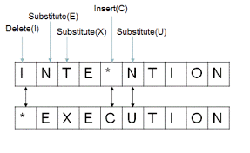
We can also assign a particular cost or weight to each of these operations
• The Levenshtein distance between two sequences is the simplest weighting factor in which each of the three operations has a cost of 1
• Levenshtein also proposed an alternative version of his metric in which each insertion or deletion has a cost of 1 and substitutions are not allowed
acress-caress
* Some works, cost of substitutions is 2, cost of transposition is 2

Slide 26

Given two strings, the source string X of length n, and target string Y of length m, we’ll define 𝑫(𝒊,𝒋) as the edit distance between 𝑿[𝟏 … .𝒊] and 𝒀[𝟏 … .𝒋], i.e., the first 𝒊 characters of X and the first 𝒋 characters of 𝒀
• The edit distance between X and Y is thus 𝑫(𝒏, 𝒎)
D[i,j] = min { D[i,j-1] +ins – cost(target [j])
D[i-1,j-1] +sub – cost(source[i], target [j])
$$\text{D}\text{[}\text{i}\text{−1,}\text{j}\text{] +}\text{del}\text{ – }\text{cost}\text{(}\text{source}\text{ [}\text{i}\text{])}$$

Slide 27
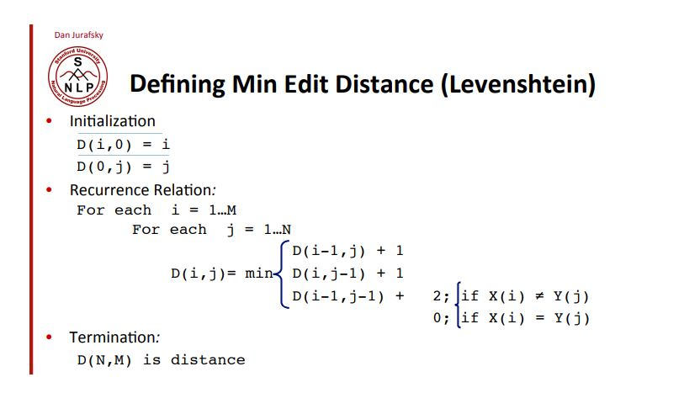

Slide 28
Minimum Edit Distance
Knowing the minimum edit distance is useful for algorithms like finding potential spelling error corrections.
But the edit distance algorithm is important in another way; with a small change, it can also provide the minimum cost alignment between two strings.
In speech recognition, minimum edit distance alignment is used to compute the word error rate.
Alignment plays a role in machine translation, in which sentences in a parallel corpus (a corpus with a text in two languages) need to be matched to each other.

